Slide 1
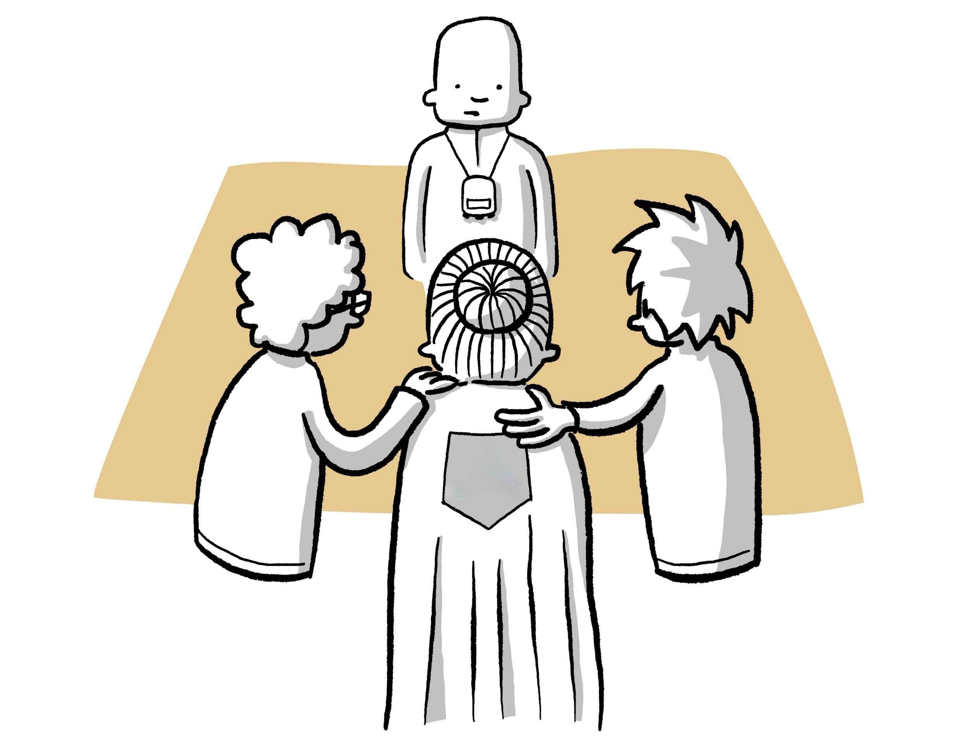
A warm welcome to today's workshop!
This is where our TEAM is created

Slide 2
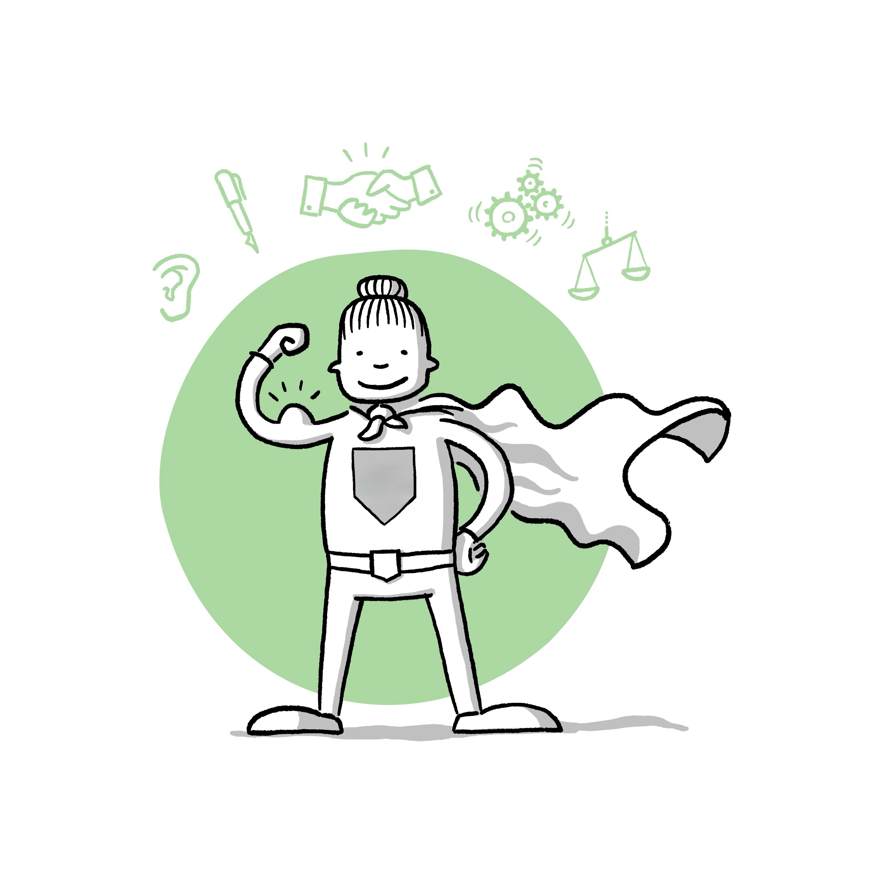
Reflection on the team game

Slide 3
Group rules for working together

